Slide 1

ICT502
Week 12: Revision
Assessment 4 Success Guide
ICT502 Applied IT Project A
1

Slide 2
Assessment 4: Project Proposal – Solution and Design Documentation
This week we will focus on:
- Reviewing Assessment 4 requirements
- Understanding what markers are looking for
- Communicating with industry stakeholders
- Identifying business problems
- Designing practical IT solutions
- Avoiding common mistakes

Slide 3
What is Assessment 4?
Your task
Develop a professional IT project proposal that includes:
✔ Problem definition
✔ Proposed solution
✔ Design documentation
✔ Sustainability considerations
✔ Ethical considerations
✔ Communication strategy
✔ Future development plan

Slide 4
Think Like an IT Consultant
Your role is not simply to describe a technology.
Your role is to:
Identify a business problem
Understand stakeholder needs
Design an IT solution
Justify your decisions

Slide 5
What Markers Want To See
Strong Projects
✓ Clear business problem
✓ Real stakeholder needs
✓ Logical solution
✓ Appropriate technologies
✓ Sustainability discussion
✓ Ethical analysis
✓ Professional communication
✓ References supporting decisions

Slide 6
Weak Projects
✗ Technology without a business problem
✗ Generic descriptions
✗ No justification
✗ No diagrams
✗ No stakeholder analysis
✗ No references

Slide 7
Example Case Study (Similar to Assessment 4)
Case Study
Sydney Community Health Centre
Current Problem:
- Uses paper-based appointment records
- Patients miss appointments
- Staff manually call patients
- High administrative workload

Slide 8
Example Case Study (Similar to Assessment 4)
Business Challenges
- Lost time
- Higher costs
- Poor patient experience
- Data management issues

Slide 9
Example Solution
Proposed IT Solution
Cloud-based Patient Appointment System
Features:
- Online booking
- SMS reminders
- Staff dashboard
- Secure patient records
- Reporting system

Slide 10
Example Solution
Modern Technologies
- Cloud Computing
- AI appointment prediction
- Mobile access
- Secure database

Slide 11
Example Functional Requirements
Functional Requirements
Users can:
- Register account
- Book appointments
- Cancel appointments
- Receive reminders
- View appointment history

Slide 12
Example Functional Requirements
Staff can:
- Manage appointments
- Generate reports
- Monitor attendance

Slide 13
Example Non-Functional Requirements
Performance
- Page loads under 3 seconds
Security
- Encrypted data
- User authentication
Reliability
- 99.9% availability
Scalability
- Support future clinic growth

Slide 14
Sustainability Example
Environmental
- Less paper usage
Social
- Improved accessibility
Economic
- Reduced administration costs

Slide 15
NSW IT Support Example
Suppose your group interviewed NSW IT Support.
What questions could you ask?

Slide 16
NSW IT Support Example
Business Questions
- What are the most common problems your clients face?
- Which industries need the most IT support?
- What services are most requested?

Slide 17
NSW IT Support Example
Project Questions
- How do you manage client projects?
- What project management method do you use?
- What project challenges occur most often?

Slide 18
NSW IT Support Example
Technology Questions
- Which cloud platforms do you recommend?
- How do you secure client data?
- What emerging technologies are becoming important?

Slide 19
Common Australian IT Challenges
Students can identify problems such as:
Cybersecurity
- Ransomware attacks
- Phishing emails
Cloud Migration
- Legacy systems
- Data migration risks

Slide 20
Common Australian IT Challenges
Remote Work
- Secure access
- Collaboration challenges
Small Business IT
- Limited budgets
- Lack of IT expertise

Slide 21
Example Problem → Solution
Problem | Proposed Solution
Phishing attacks | AI email filtering
Slow helpdesk response | Ticket automation
Manual records | Cloud database
Weak passwords | MFA implementation
Remote access issues | VPN + Zero Trust

Slide 22
Assessment 4 Section-by-Section Guide
Section 1
Executive Summary
Answer:
- What problem exists?
- What solution do you propose?
- Why is it valuable?

Slide 23
Assessment 4 Section-by-Section Guide
Section 2
Problem Definition
Answer:
- Who is affected?
- What impact does it have?
- Why does it matter?

Slide 24
Assessment 4 Section-by-Section Guide
Section 3
Solution Proposal
Answer:
- What system will you build?
- How will it work?
- Why is it better?

Slide 25
Assessment 4 Section-by-Section Guide
Section 4
Design Documentation
Include:
- Architecture diagram
- ERD
- Technology stack
- Security design

Slide 26
Assessment 4 Section-by-Section Guide
Section 5
Ethics and Management
Discuss:
- Privacy
- Security
- Bias
- Accessibility
- Team communication

Slide 27
Assessment 4 Section-by-Section Guide
Section 6
Communication and Future Development
Explain:
- Stakeholder communication
- Future improvements
- Skills gained

Slide 28
What To Submit
Submit One Group Report
Requirements:
✓ Approximately 2,000 words
✓ Group submission
✓ APA references
✓ Diagrams
✓ Technology justification
✓ Ethical analysis
✓ Communication plan
✓ Conclusion

Slide 29
Common Mistakes To Avoid
Avoid
✗ Copying vendor websites
✗ Describing technology only
✗ Missing references
✗ Missing diagrams
✗ No sustainability discussion
✗ No stakeholder analysis
✗ No ethical considerations
✗ No justification for technology choices

Slide 30
Final Assessment 4 Tips
Before Submission
Ask yourself:
✓ Have we clearly identified the problem?
✓ Have we proposed a realistic solution?
✓ Have we justified our technologies?
✓ Have we included sustainability?
✓ Have we discussed ethics?
✓ Have we explained communication?
✓ Have we included references?

Slide 31
Discussion Questions
Q1. Why is it important to understand the business problem before selecting a technology?
Because technology should solve a real business need rather than being used simply because it is new or popular.

Slide 32
Discussion Questions
Q2. What information should students gather from NSW IT Support?
Client challenges, project management practices, technology recommendations, security concerns, and future industry trends.

Slide 33
Discussion Questions
Q3. What makes a project proposal sustainable?
Reducing environmental impact, improving accessibility, supporting ethical practices, and being cost-effective.

Slide 34
Discussion Questions
Q4. Why should ethical issues be discussed in Assessment 4?
Because IT solutions may affect privacy, security, accessibility, fairness, and legal compliance.

Slide 35
Discussion Questions
Q5. What is the difference between a business problem and a technology solution?
A business problem is the issue that needs solving; the technology solution is the tool used to solve that issue.

Slide 36
Discussion Questions
Q6. Why is stakeholder communication important?
It ensures that requirements are understood, expectations are managed, and feedback is incorporated throughout the project.

Slide 37
Discussion Questions
Q7. What is one thing that often lowers marks in Assessment 4?
Providing a technology description without clearly explaining the business problem, stakeholder needs, and justification for the solution.

Slide 38
Final Revision Message for Students
Assessment 4 is not a technical report about technology. It is a professional project proposal that demonstrates your ability to identify a real problem, analyse stakeholder needs, design a practical IT solution, justify your decisions, and communicate professionally using project management principles.

Slide 39
Week 12 Revision Questions
Question 1
What is a project?
A project is a temporary activity with a clear start and finish that aims to achieve a specific goal or deliverable.

Slide 40
Week 12 Revision Questions
Question 2
What is the first step in the design process?
Research and requirements gathering to understand the problem and stakeholder needs.

Slide 41
Week 12 Revision Questions
Question 3
Why is requirements gathering important?
It helps ensure the final solution meets user and business needs.

Slide 42
Week 12 Revision Questions
Question 4
Give two ways to gather requirements.
Interviews
Surveys
Other examples include observation, workshops, and questionnaires.

Slide 43
Week 12 Revision Questions
Question 5
Who is a stakeholder?
Anyone affected by the project or who has an interest in the project.
Examples:
Customers
Managers
Employees
IT staff

Slide 44
Week 12 Revision Questions
Question 6
What is UML?
Unified Modelling Language (UML) is a visual language used to design and document systems.

Slide 45
Week 12 Revision Questions
Question 7
Why do we use UML diagrams?
To help stakeholders understand how a system works and improve communication.

Slide 46
Week 12 Revision Questions
Question 8
What is an ERD?
An Entity Relationship Diagram that shows data entities, attributes, and relationships.

Slide 47
Week 12 Revision Questions
Question 9
Name three modern technologies that can be used in IT projects.
Artificial Intelligence (AI)
Cloud Computing
Internet of Things (IoT)

Slide 48
Week 12 Revision Questions
Question 10
What are the five project life cycle phases?
Initiation
Planning
Execution
Monitoring and Control
Closure

Slide 49
Week 12 Revision Questions
Question 11
Why is communication important in projects?
Communication helps team members stay informed, manage risks, and meet project goals.

Slide 50
Week 12 Revision Questions
Question 12
What should be included in a communication plan?
Stakeholders
Communication methods
Frequency
Responsibilities

Slide 51
Week 12 Revision Questions
Question 13
What is a project report used for?
To communicate project progress, findings, decisions, and recommendations.

Slide 52
Week 12 Revision Questions
Question 14
Why do organisations evaluate projects?
To determine whether project goals were achieved and identify lessons learned.

Slide 53
Week 12 Revision Questions
Question 15
Give one example of an ethical issue in IT projects.
Data privacy.
Other examples:
Accessibility
AI bias
Intellectual property
Cybersecurity

Slide 54
Week 12 Revision Questions
Question 16
Why is data privacy important?
Because organisations must protect personal information and comply with laws and regulations.

Slide 55
Week 12 Revision Questions
Question 17
What is Agile project management?
A flexible project management approach that delivers work in small stages and welcomes feedback.

Slide 56
Week 12 Revision Questions
Question 18
What is one advantage of Agile?
It allows teams to adapt to changing requirements quickly.

Slide 57
Week 12 Revision Questions
Question 19
What is one difference between Agile and Waterfall?
Agile is flexible and iterative.
Waterfall follows a fixed sequence of stages.

Slide 58
Week 12 Revision Questions
Question 20
What is the most important thing to remember for Assessment 4?
Focus on solving a real business problem by proposing a practical IT solution supported by design documentation, sustainability, ethics, project management principles, and research.

Slide 59
Assessment 4 Revision Questions
These questions directly prepare you for the assessment.
Q21
What problem is your project trying to solve?
Students should clearly explain the business or organisational problem.

Slide 60
Assessment 4 Revision Questions
Q22
Who are the stakeholders in your project?
Identify users, managers, customers, IT staff, and other affected parties.

Slide 61
Assessment 4 Revision Questions
Q23
Why is your proposed solution better than the current approach?
Explain benefits such as efficiency, cost savings, security, or improved user experience.

Slide 62
Assessment 4 Revision Questions
Q24
Which technologies will your project use?
Examples:
Cloud Computing
AI
Databases
Mobile Apps
Web Applications

Slide 63
Assessment 4 Revision Questions
Q25
How does your project support sustainability?
Examples:
Reduced paper use
Improved accessibility
Lower operational costs
Energy-efficient systems

Slide 64
Assessment 4 Revision Questions
Q26
What ethical issues may arise in your project?
Examples:
Privacy
Security
Accessibility
Bias

Slide 65
Assessment 4 Revision Questions
Q27
How will you communicate with stakeholders?
Examples:
Email
Meetings
Microsoft Teams
Reports

Slide 66
Assessment 4 Revision Questions
Q28
What diagrams should be included in Assessment 4?
Examples:
ERD
UML diagrams
Architecture diagrams
Data flow diagrams

Slide 67
Assessment 4 Revision Questions
Q29
Why must you justify your technology choices?
To show that the selected technologies are appropriate, realistic, and aligned with business needs.

Slide 68
Assessment 4 Revision Questions
Q30
Is Assessment 4 an individual or group assessment?
It is a group assessment.
One submission should be made per group.

Slide 69
Assessment 4 Revision Questions
Final Reflection Question) If you were presenting your project proposal to a real Australian company, would they understand:
The problem?
The solution?
The benefits?
The risks?
The cost and value?

Slide 70
Assessment 4 Revision Questions
If the answer is yes, then your Assessment 4 is likely on the right track.
This final reflection question often creates excellent discussion and helps you identify gaps before submission.

Slide 71
Week 1: Introduction to Project Design and Proposals
Definition: The design process is a systematic series of steps that helps teams plan, develop, and refine project proposals and solutions.
Stages:
Research and Requirements Gathering: Understanding the problem and stakeholder needs.
Concept Development: Generating ideas and possible solutions.
Design and Prototyping: Creating detailed plans and initial models.
Implementation: Building the project based on the design.
Testing and Evaluation: Verifying that the solution meets requirements.
Deployment and Maintenance: Delivering the solution and ongoing support.

Slide 72
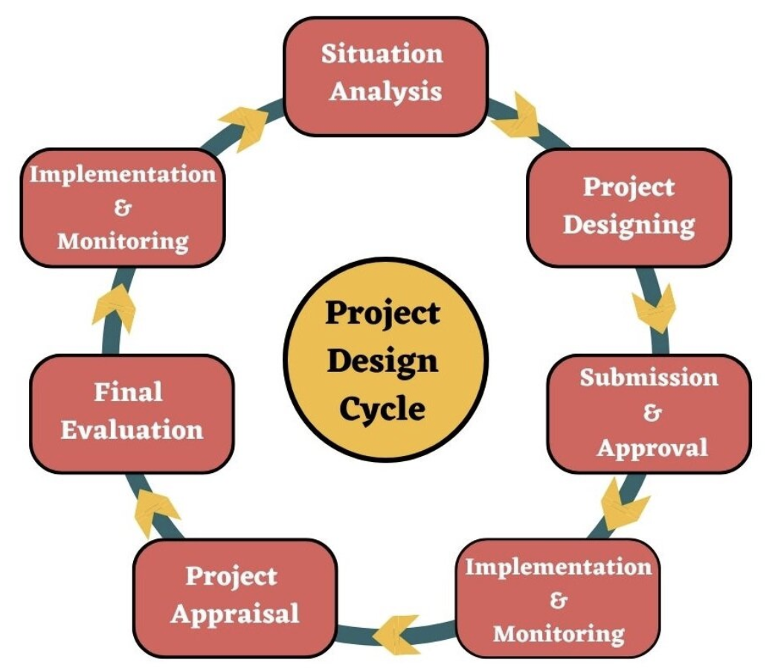
Introduction to the Design Process(Cont.)

Slide 73
Project Proposal
Executive Summary
Background/Introduction
Objectives
Scope
Methodology
Timeline
Budget
Risk Management
Conclusion

Slide 74
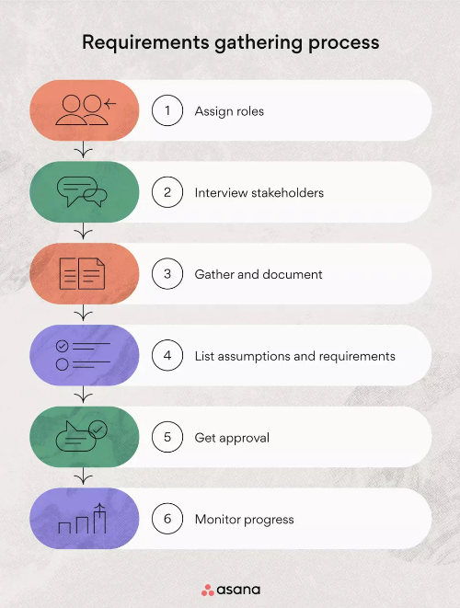
Week 2 : Requirement Gathering Techniques and Design Thinking
To gather your requirements, use the six-step process.
Once you’re finished, you should have a comprehensive requirements document outlining the resources you need to move forward through the project phases.

Slide 75
Data Collection Techniques
Techniques:
Literature reviews: Analysing existing research and publications
Case studies: In-depth analysis of specific examples
Field studies: Observing and collecting data in real-world settings
Experimental research: Testing hypotheses under controlled conditions

Slide 76
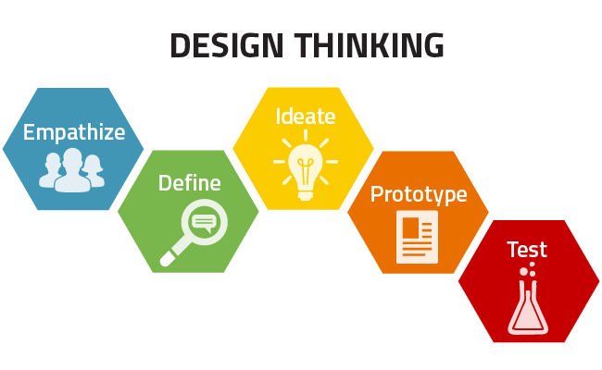
Design Thinking in IT Project
Design Thinking:
Design Thinking is a human centric approach to innovation, which allows the organisation or innovators to focus on the people that they are creating for. This focus leads to services, process and/or products which start with the users is mind rather than thinking about then as just a part of the solution.

Slide 77
Week 3: Evaluating Design Options for IT Projects
What is a Project Evaluation?
The project evaluation is a methodology developed to identify a project’s success and impact in the market. It’s also applied to programs and policies.
Overview
Objective Assessment: Evaluates if project goals were achieved.
Performance Review: Assesses schedule, budget, and deliverable quality.
Stakeholder Satisfaction: Gauges feedback from stakeholders.
Benefit Realisation: Measures achieved benefits like cost savings or efficiency gains.
Risk and Issue Management: Reviews effectiveness in handling risks and issues.
Lessons Learned: Captures insights for future improvements and practices.

Slide 78
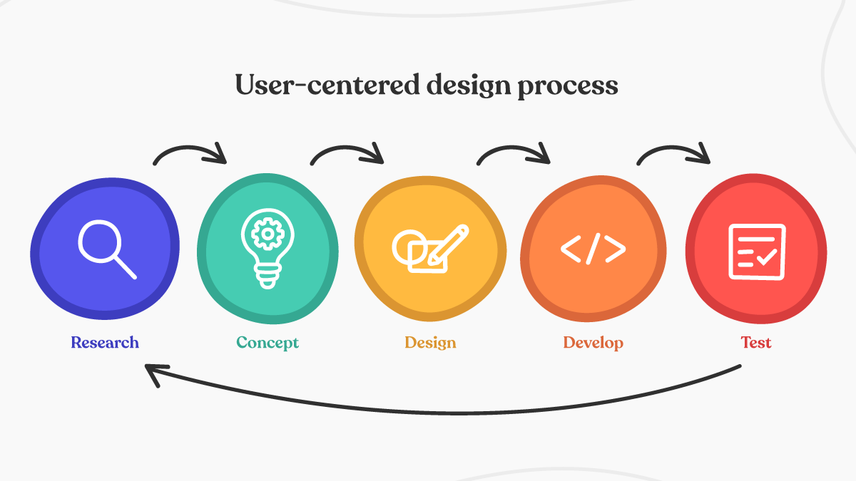
User-Centered Design Approaches in IT Projects

Slide 79
Week 4: Introduction to Modelling & UML
Definition and History of UML:
UML (Unified Modelling Language) is a standardised modelling language developed by Object Management Group (OMG) in the 1990s.
Objectives of UML:
Provide a standard way to visualise the design of a system.
Facilitate communication and understanding among stakeholders.
Benefits of Using UML:
Improves clarity and accuracy in system design.
Supports various stages of software development.
Enhances collaboration and reduces ambiguity.

Slide 80
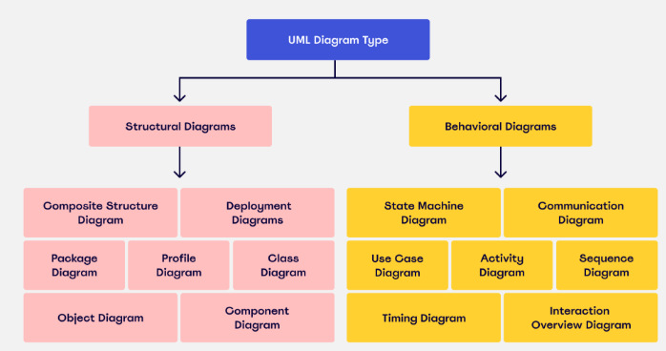
What is UML ?

Slide 81
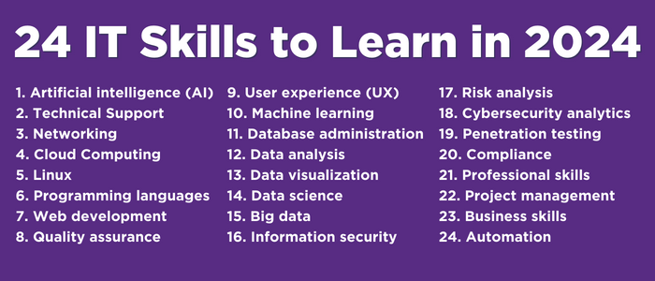
Week 5: Skills and Capabilities in IT Projects

Slide 82
Understanding Patents in IT Projects
Patents:
Patents protect inventions and innovations, granting exclusive rights to inventors. They are crucial for safeguarding intellectual property.
Claims Analysis:
Involves scrutinising patent claims to decipher the specific features and functionalities that are protected. This analysis guides IT project teams in understanding what aspects of their innovations could potentially infringe on existing patents.
Impact on IT Landscape:
Patents shape the competitive dynamics within the IT industry by influencing product development strategies, dictating licensing terms for using patented technologies, and impacting market positioning through exclusivity rights.

Slide 83
Understanding Prior Art in IT Projects (Cont.)
Prior Art Searches:
Conduct comprehensive searches across patent databases and scientific literature to identify prior art—existing technologies or solutions that may invalidate a patent claim or inspire alternative approaches in IT projects.
Search Methods:
Utilise comprehensive strategies such as exploring patent databases (e.g., USPTO, WIPO), reviewing scientific literature, attending conferences, and leveraging online repositories.
Evaluation Criteria:
Assess the relevance of prior art based on its similarity to the proposed innovation, temporal proximity, technological impact, and applicability to the project's objectives.

Slide 84
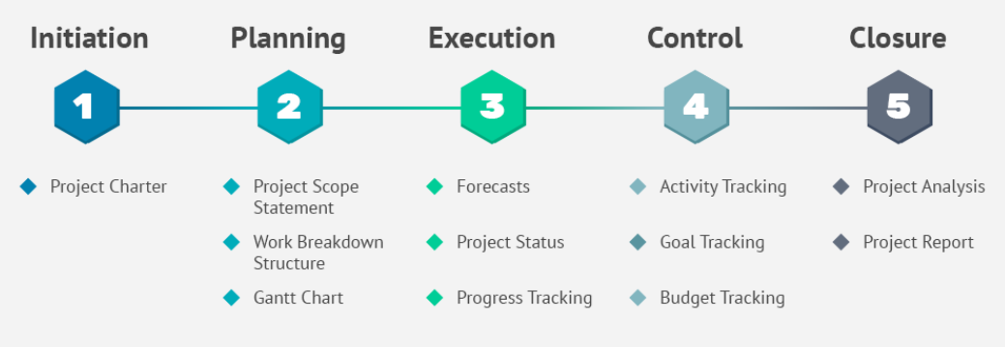
Week 6: Project Implementation
The 5 Phases of The Project Life Cycle:

Slide 85
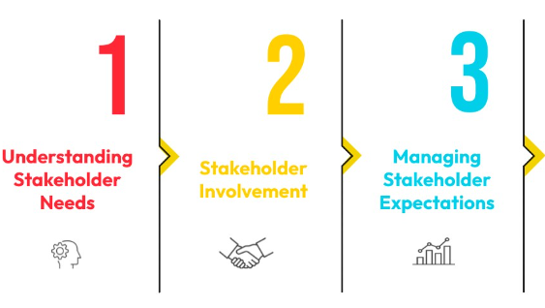
Stakeholder Engagement Planning
Identifying Stakeholders: Mapping stakeholders based on their influence and interest in the project.
Engagement Strategies: Involving stakeholders in decision-making, providing updates, and gathering feedback.

Slide 86
Week 7: Effective Communication Skills in IT Projects
Overview of Communication in IT Projects:
Project Coordination: Effective communication ensures that all team members are on the same page regarding project goals, timelines, and deliverables.
Stakeholder Engagement: Clear and consistent communication helps in managing stakeholder expectations and keeping them informed about project progress.
Risk Management: Timely communication allows for the early identification and mitigation of risks, preventing potential issues from escalating.

Slide 87
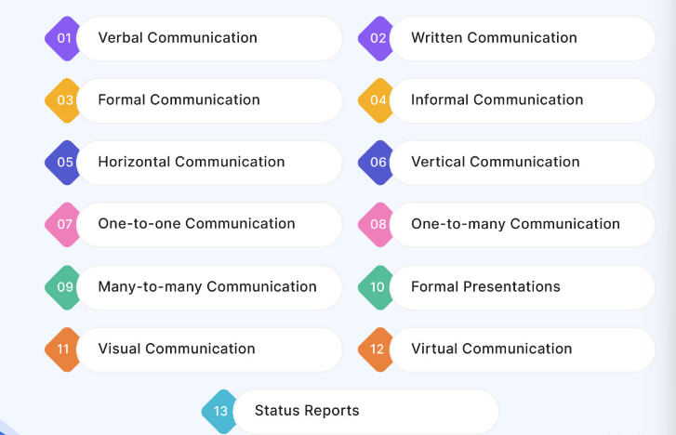
Types of Communication in Project Management

Slide 88
Week 8: Writing and Presenting IT Project Reports
Understanding Project Reports
Definition and Purpose: IT project reports are structured documents that communicate project progress, outcomes, and insights to stakeholders.
Importance: They ensure clear communication, inform decision-making, and align stakeholders towards project goals.
Types of IT Project Reports
Progress Reports: Updates on project activities and achievements.
Status Updates: Current project status and upcoming tasks.
Technical Documentation: Detailed project specifications and design decisions.
Final Project Reports: Summarise project lifecycle, outcomes, and recommendations.

Slide 89
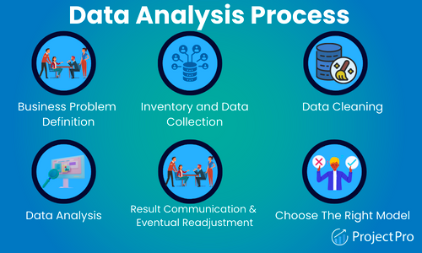
Gathering the Facts and Data

Slide 90
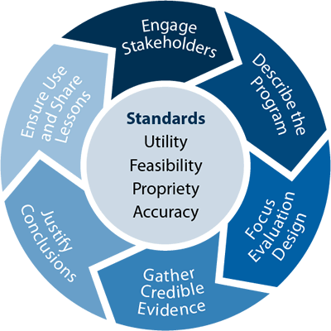
Week 9: Project Evaluation and Reflection
Overview of Project Evaluation in IT:
Project evaluation in IT focuses on assessing the effectiveness, efficiency, and success of IT initiatives, such as software development, system upgrades, or infrastructure enhancements.
Importance of evaluating IT projects to ensure alignment with organisational goals, budget adherence, and stakeholder satisfaction.

Slide 91
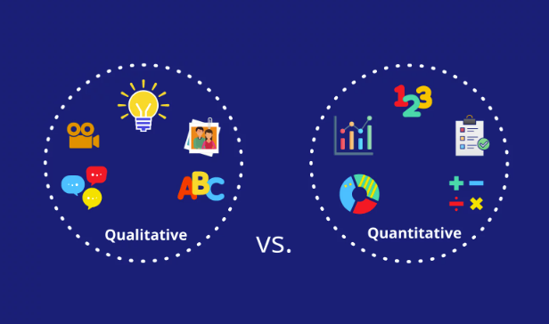
Quantitative VS. Qualitative

Slide 92
Critical Reflection on Project Performance
Benefits of Critical Reflection:
Improved Decision-Making: Helps in making informed decisions based on past experiences and lessons learned.
Enhanced Team Collaboration: Fosters an environment of continuous learning and open communication among team members.
Identification of Best Practices: Allows the organisation to document and replicate successful strategies in future projects.
Risk Management: Aids in identifying potential risks early and developing mitigation strategies.

Slide 93
Week 10: Ethical and Management Issues in IT Projects
Key Components of Ethical Decision-Making
Identifying Ethical Issues:
Recognising situations where moral values or principles may be at stake.
Considering Stakeholder Interests:
Evaluating how decisions impact various stakeholders, including employees, customers, and the broader community.
Example: Assessing the environmental impact of project activities and stakeholders' concerns.
Applying Ethical Theories and Frameworks:
Utilitarianism: Maximising overall benefit while minimising harm.
Deontology: Adhering to moral rules and principles regardless of outcomes.
Virtue Ethics: Emphasising character traits and ethical virtues in decision-making.

Slide 94
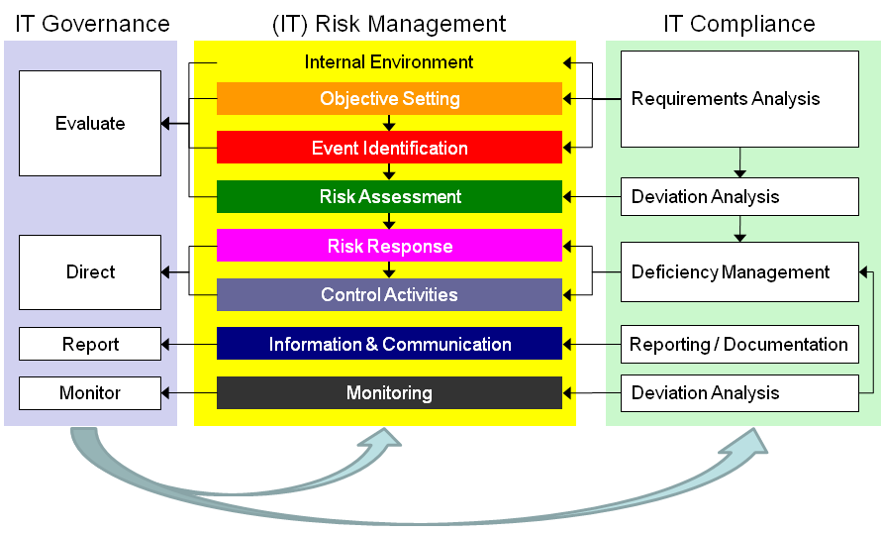
IT Governance and Compliance

Slide 95
Week 11: Project Management Principles and Practices
Overview of Agile Methodology
Agile methodologies originated as a response to traditional, plan-driven approaches (like Waterfall), focusing on iterative development, flexibility, and customer collaboration.
Agile is characterised by its iterative cycles (sprints), continuous feedback loops, and the ability to adapt to changing requirements throughout the project lifecycle.
Agile frameworks, such as Scrum and Kanban, emphasise teamwork, self-organisation, and delivering incremental value to stakeholders.

Slide 96
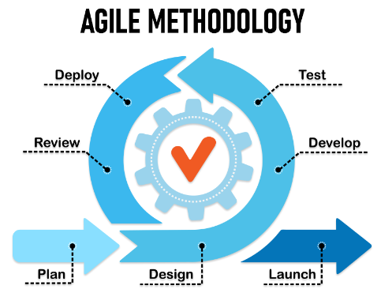
Project management methodologies: Agile

Slide 97
Project management methodologies: Waterfall
Overview of Waterfall Methodology
Waterfall methodology is a sequential project management approach that follows a linear and structured process flow. It is characterised by its distinct phases, where progress flows downwards (like a waterfall) through each phase before proceeding to the next.

Slide 98
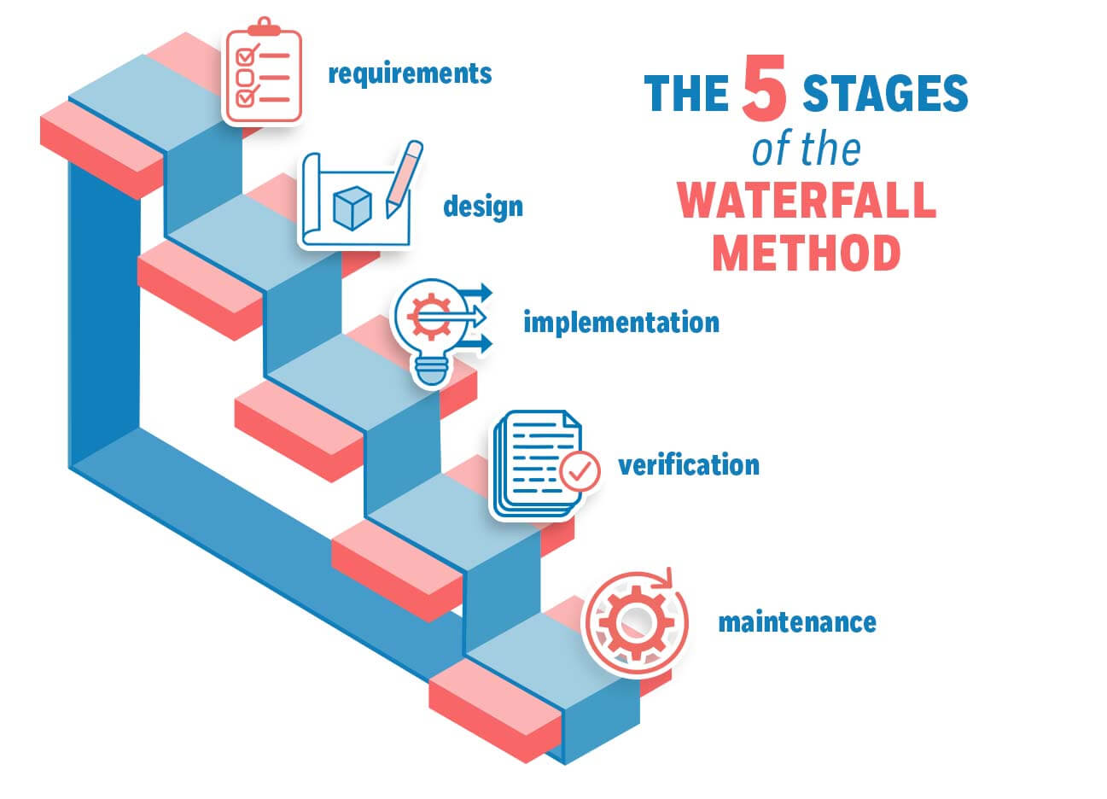
Project management methodologies: Waterfall (cont.)

Slide 99
Tools and Software for Project Management
Types of Project Management Tools
Task Management Tools:
Features: Create, assign, and track tasks; set deadlines and priorities; collaborate on task status.
Examples: Asana, Trello, Jira.
Collaboration Tools:
Features: Facilitate team communication, file sharing, real-time editing, and document management.
Examples: Microsoft Teams, Slack, Google Workspace.
Scheduling Tools:
Features: Create project timelines, manage dependencies, allocate resources, and monitor progress.
Examples: Microsoft Project, Smartsheet, Monday.com.

Slide 100
Q&A
Question?

